Slide 1
Graph Paper Programming

Slide 2
Goals For this Activity
Learn to convert real-world activities into instructions
Gain practice coding instructions with symbols
Gain understanding of the need for precision in coding
Notes:
Tip: Add your own speaker notes here.

Slide 3

Exercise
Teach the computer to draw a simple image on graph paper

Slide 4
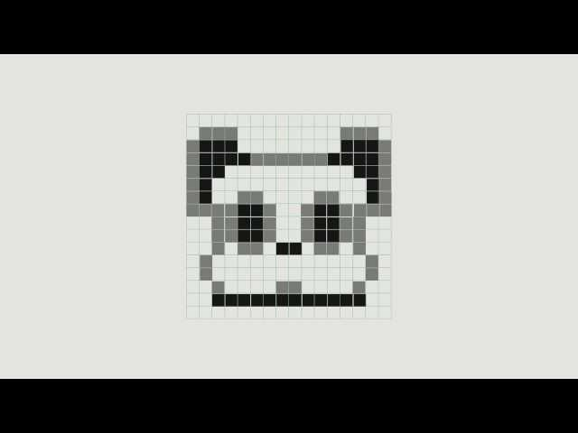
Video : Hour of Code Unplugged Activity
Notes:
Video from hour of code

Slide 5
You can only use these commands:
Move One Square Forward
Move One Square Backward
Move One Square Down
Fill In The Square

Slide 6
Teach the Computer to draw this Image
Lets assume the starting position is top left corner
Code
Sample Algorithm
Step Forward, Fill-in, Step Forward,
Step down, Back, Back
Fill-in, Step forward, Step Forward, Fill-in,
Next Row, Back, Back
Step Forward, Fill-in, Step Forward
Notes:
We could delete this slide and use the next one

Slide 7
More efficient Code
Lets assume the starting position is top left corner
Sample Algorithm
Step Forward, Fill-in, Step Forward, Step down, Fill-in, Step forward, Step Forward, Fill-in, Step down, Step Forward, Fill-in, Step Forward
Code

